Slide 1

CALCULUS
Chapter 3 APPLICATIONS OF DIFFERENTIATION

Slide 2
3.1. Maximum and minimum.
3.2. Mean value theorem.
3.3. Derivates and the shapes of Graphs.
3.5. Optimization Problems.
3.6. Newton’s Method.
3.7. Antiderivatives.

Slide 3
3.1. Maximum and Minimum Values
In this section, we will learn:
How to find the maximum
and minimum values of a function.

Slide 4
Remind:
absolute maximum → Giá trị lớn nhất → max
absolute minimum → Giá trị nhỏ nhất → min
local maximum → Cực đại địa phương → cực đại
local minimum → Cực tiểu địa phương → cực tiểu

Slide 5
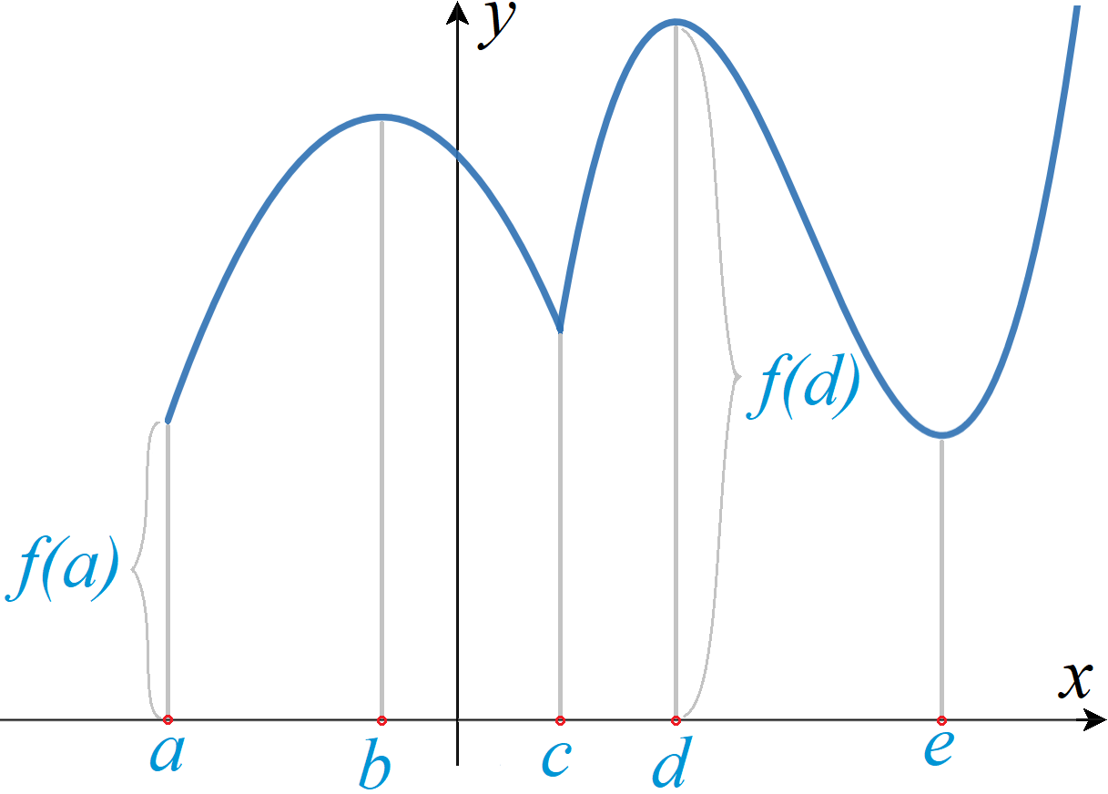
MAXIMUM & MINIMUM VALUES
Definition 1:
A function f has an absolute maximum (or global maximum) at d if f(d) ≥ f(x) for all x in D, where D is the domain of f.
The number f(d) is called the maximum value of f on D.
(d, f(d)) is the highest point on the graph.

Slide 6
MAXIMUM & MINIMUM VALUES
Definition 2:
Similarly, f has an absolute minimum at c if f(a) ≤ f(x) for all x in D and the number f(a) is called the minimum value of f on D.
The maximum and minimum values of f are called the extreme values of f.
(a, f(a)) is the lowest point on the graph.

Slide 7
MAXIMUM & MINIMUM VALUES
Definition 3:
A function f has a local maximum (or relative maximum) at c if f(c) ≥ f(x) when x is near c.
Similarly, f has a local minimum at c if f(c) ≤ f(x) when x is near c.
In which: x is near c, means:

Slide 8
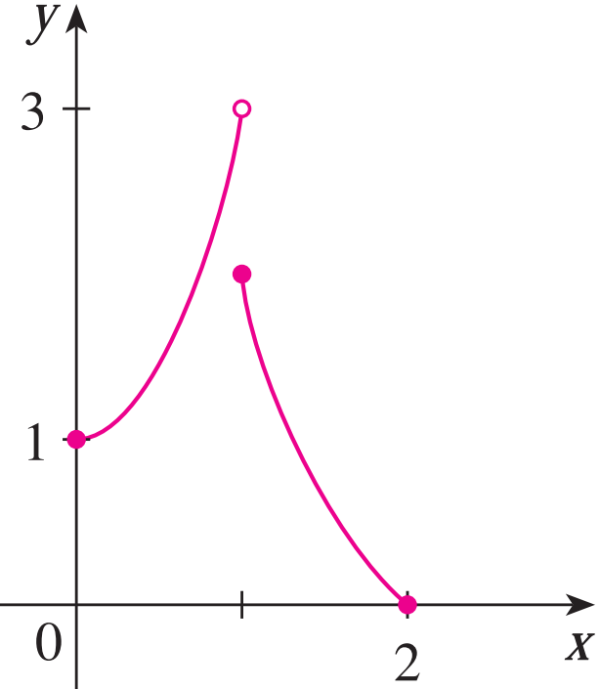
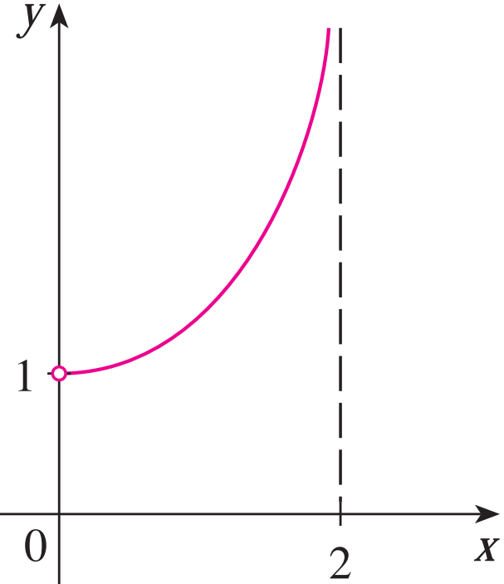
EXTREME VALUE THEOREM
In the first figure, why isn’t y = 3 the absolute maximum value?
In the second figure, does it have the absolute maximum and minimum value?

Slide 9
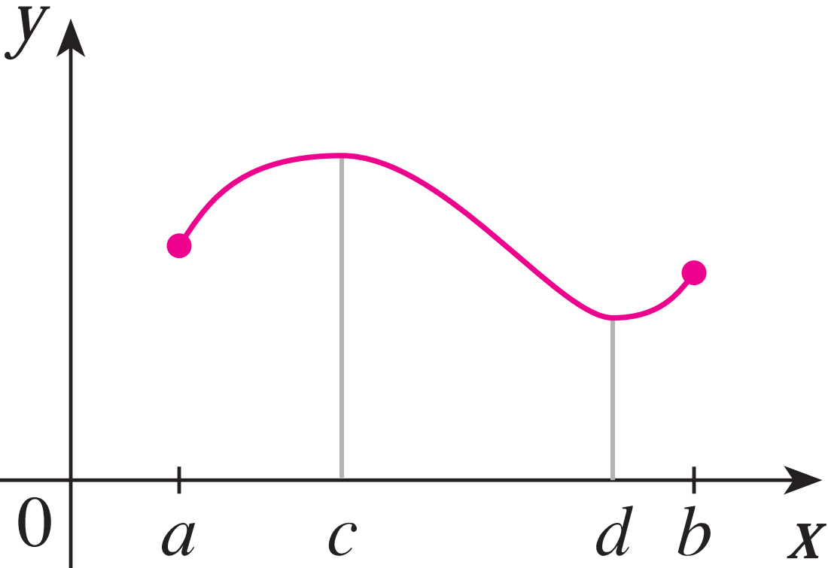
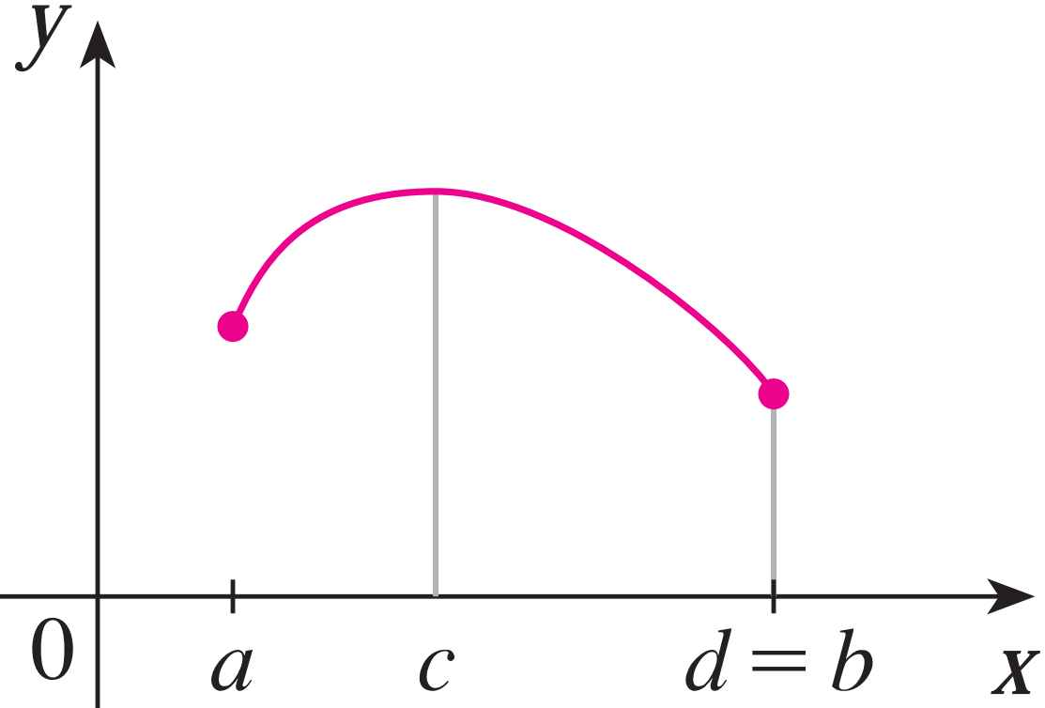
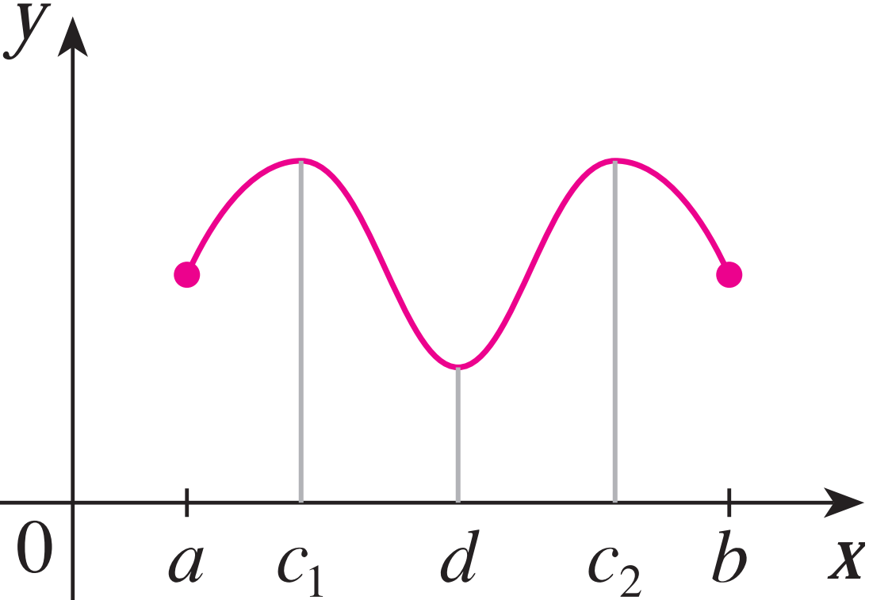
EXTREME VALUE THEOREM
Theorem:
If f is continuous on a closed interval [a, b], then f attains an absolute maximum value f(c) and an absolute minimum value f(d) at some numbers c and d in [a, b].

Slide 10
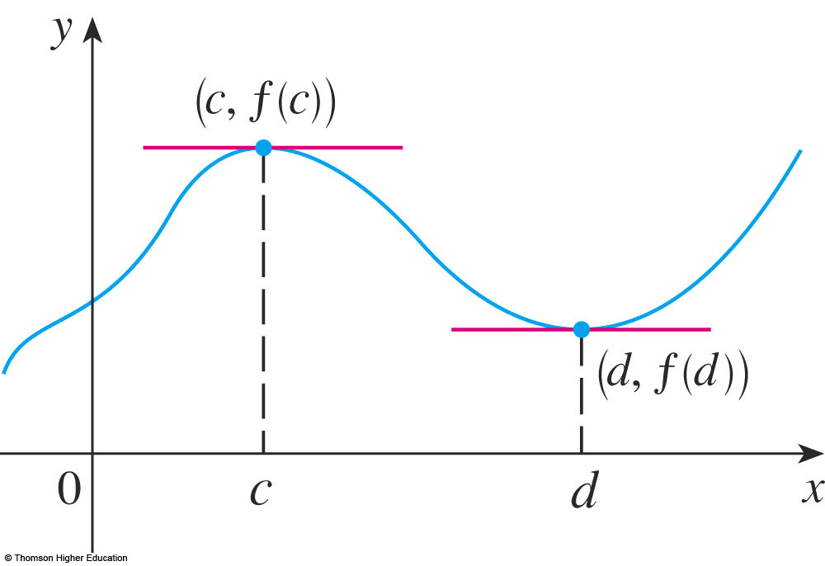
EXTREME VALUE THEOREM
The theorem does not tell us how to find these extreme values.
We start by looking for local extreme values.

Slide 11
EXTREME VALUE THEOREM
FERMAT’S THEOREM.
If f has a local maximum or minimum at c, and if f ’(c) exists, then f ’(c) = 0.

Slide 12
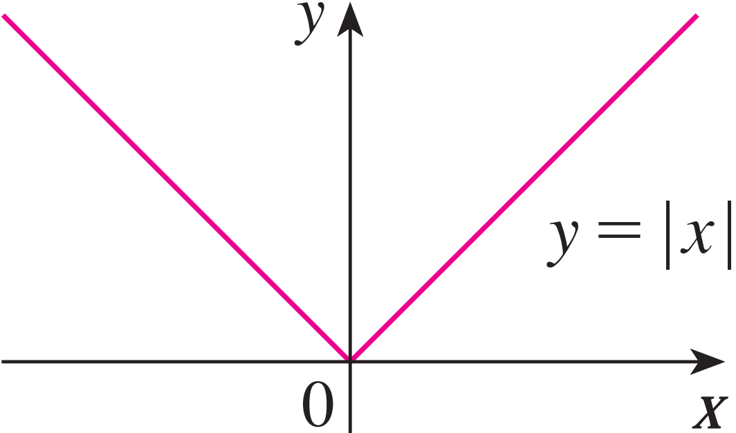
EXTREME VALUE THEOREM
Is it true if say that
“ f’(c) = 0 if f has local extreme value at c ? ”
Consider the following example:
The function f(x) = |x| has its (local and absolute) minimum value at 0.
f’(0) does not exist.
Answer: It is false

Slide 13

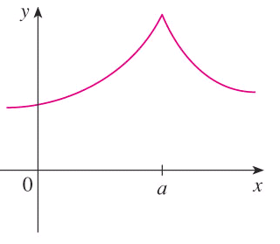
CRITICAL NUMBERS
Definition: CRITICAL NUMBERS
A critical number (giá trị tới hạn) of a function f is a number c in the domain of f such that either f’(c) = 0 or f’(c) does not exist.

Slide 14
CRITICAL NUMBERS
Theorem:
If f has a local maximum or minimum at c, then c is a critical number of f.

Slide 15
CLOSED INTERVAL METHOD
To find the absolute maximum and minimum values of a continuous function f on a closed interval [a, b]:
Find the values of f at the critical numbers of f in (a, b).
Find the values of f at the endpoints of the interval.
The largest value from 1 and 2 is the absolute maximum value. The smallest is the absolute minimum value.

Slide 16
Using Derivatives to Find Absolute Maximum and Minimum Values
Example 1: Find the absolute maximum and minimum values of
Step 1:
Step 2: Note that f ′(x) exists for all real numbers:
Step 3:
Step 4:

Slide 17
Select the correct ones.
Select the correct ones.
a. If f ′(c) = 0 then f has the local maximum or minimum at c.
b. If f has the absolute minimum value at c then f ′(c) = 0.
c. If f is continuous on (a, b) then f attains an absolute maximum value f(c) and an absolute minimum value f(d) for some c and d in (a, b).
d. All of the above.
e. None of the above.

Slide 18
3.2. APPLICATIONS OF DIFFERENTIATION The Mean Value Theorem
In this section, we will learn about:
The significance of the mean value theorem.

Slide 19
ROLLE’S THEOREM
Theorem: Let f be a function that satisfies the following three hypotheses:
f is continuous on the closed interval [a, b]
f is differentiable on the opened interval (a, b)
f(a) = f(b)
Then, there is a number c in (a, b) such that f’(c) = 0.

Slide 20
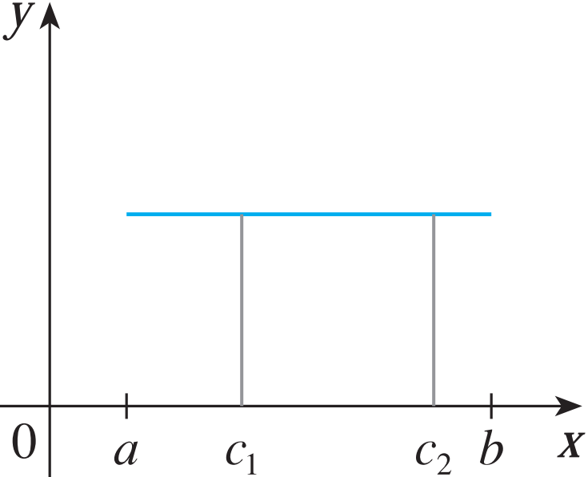
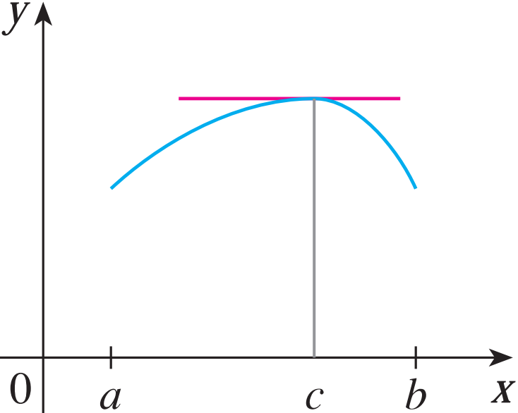
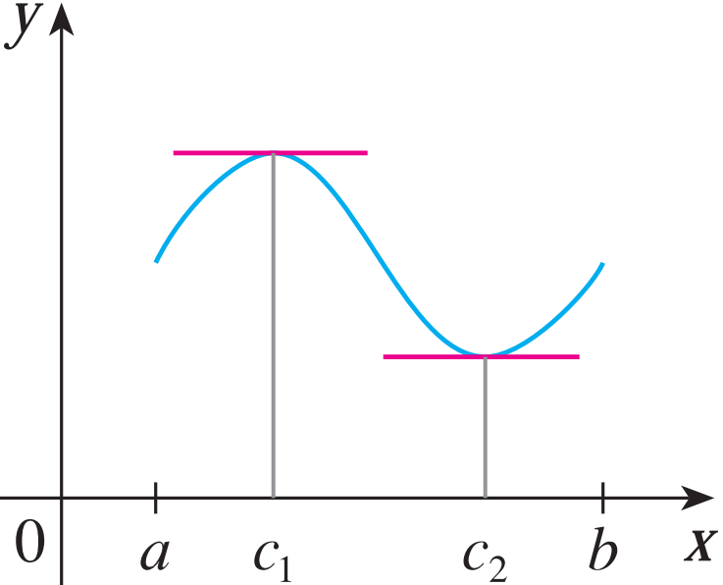
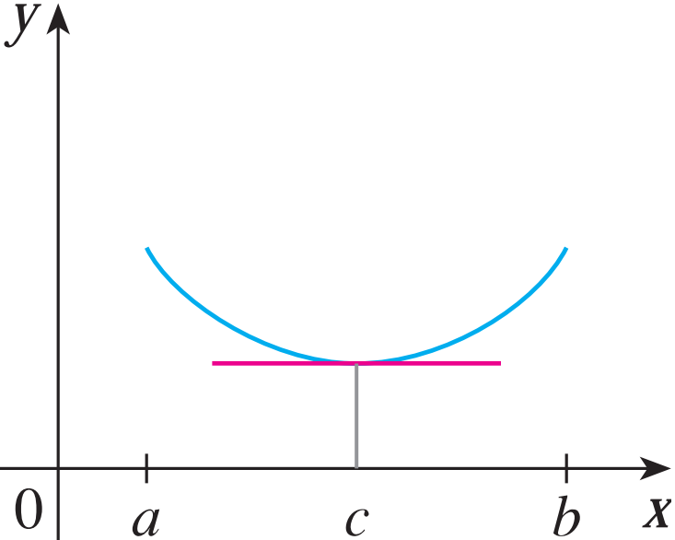
ROLLE’S THEOREM
The figures show the graphs of four such functions.

Slide 21
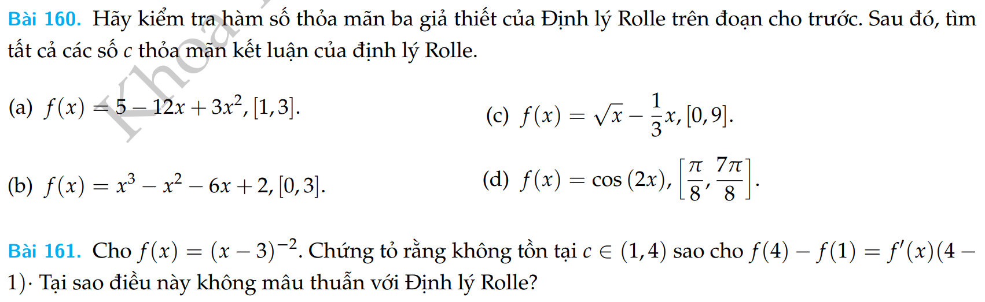
ROLLE’S THEOREM

Slide 22
MEAN VALUE THEOREM (LAGRANGE)
Theorem: Let f be a function that fulfills two hypotheses:
f is continuous on the closed interval [a, b].
f is differentiable on the open interval (a, b).
Then, there is a number c in (a, b) such that
or, equivalently,

Slide 23
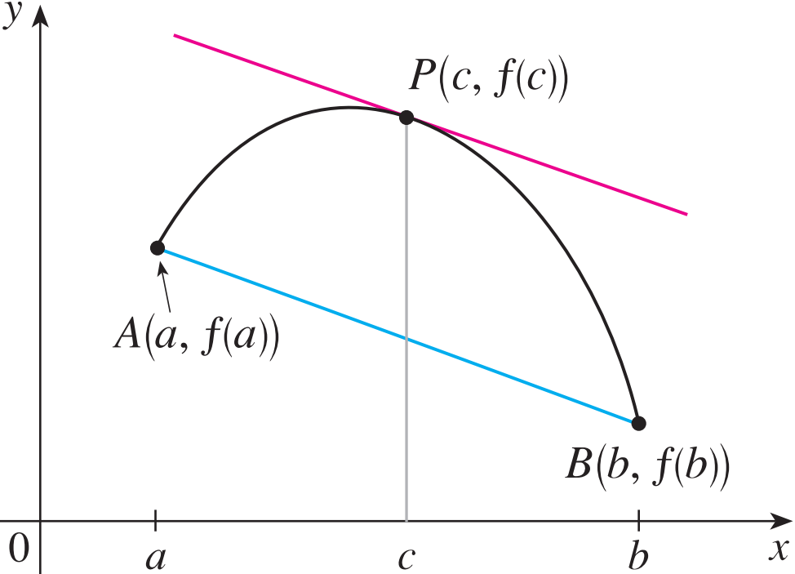
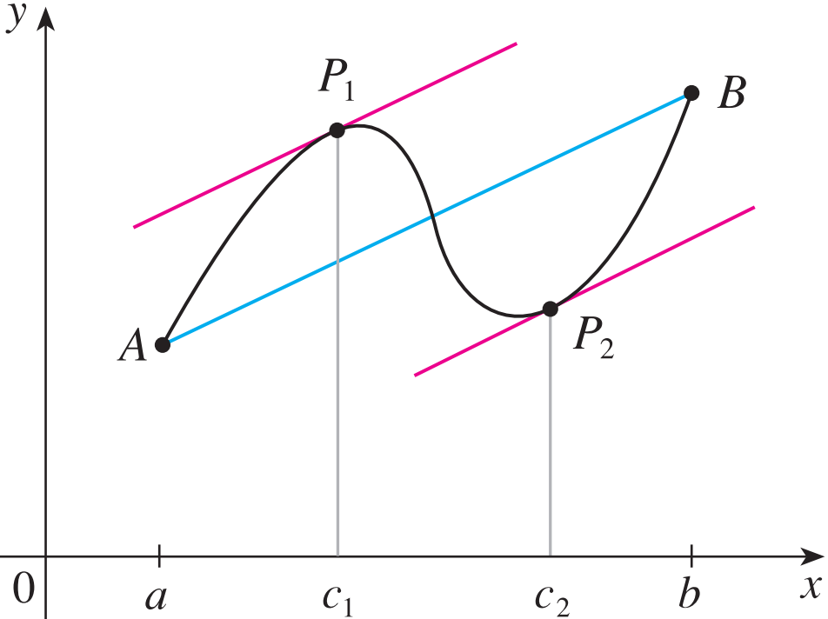
MEAN VALUE THEOREM (LAGRANGE)
If f ’(c) is the slope of the tangent line at (c, f(c)) then
There is at least one point P(c, f(c)) on the graph where the slope of the tangent line is the same as the slope of the secant line AB.

Slide 24
MEAN VALUE THEOREM (LAGRANGE)
Example: Suppose that f (0) = -3 and f ’(x) ≤ 5 for all values of x. How large can f(2) possibly be?
⇒We are given that f is differentiable - and therefore continuous - everywhere.
⇒ In particular, we can apply the Mean Value Theorem on the interval [0, 2].
There exists a number c such that f(2) – f(0) = f ’(c)(2 – 0)
So, f(2) = – 3 + 2 f ’(c)

Slide 25
MEAN VALUE THEOREM (LAGRANGE)
Example: Suppose that f (0) = -3 and f ’(x) ≤ 5 for all values of x. How large can f(2) possibly be?
We had f(2) = – 3 + 2 f ’(c).
We are given that f ’(x) ≤ 5 ,∀x
⇒ f ’(c) ≤ 5 ⇒ 2 f ’(c) ≤ 10 ⇒ f(2) = – 3 + 2 f ’(c) ≤ – 3 + 10 = 7
The largest possible value for f(2) is 7.

Slide 26
MEAN VALUE THEOREM (LAGRANGE)
Theorem:
If f ’(x) = 0 for all x in an interval (a, b), then f is constant on (a, b).
Corollary:
If f ’(x) = g’(x) for all x in an interval (a, b), then f – g is constant on (a, b).
That is, f(x) = g(x) + c where c is a constant.

Slide 27
3.3. APPLICATIONS OF DIFFERENTIATION Derivatives and the Shapes of Graphs
In this section, we will learn:
How the derivative of a function gives us the direction in which the curve proceeds at each point.

Slide 28
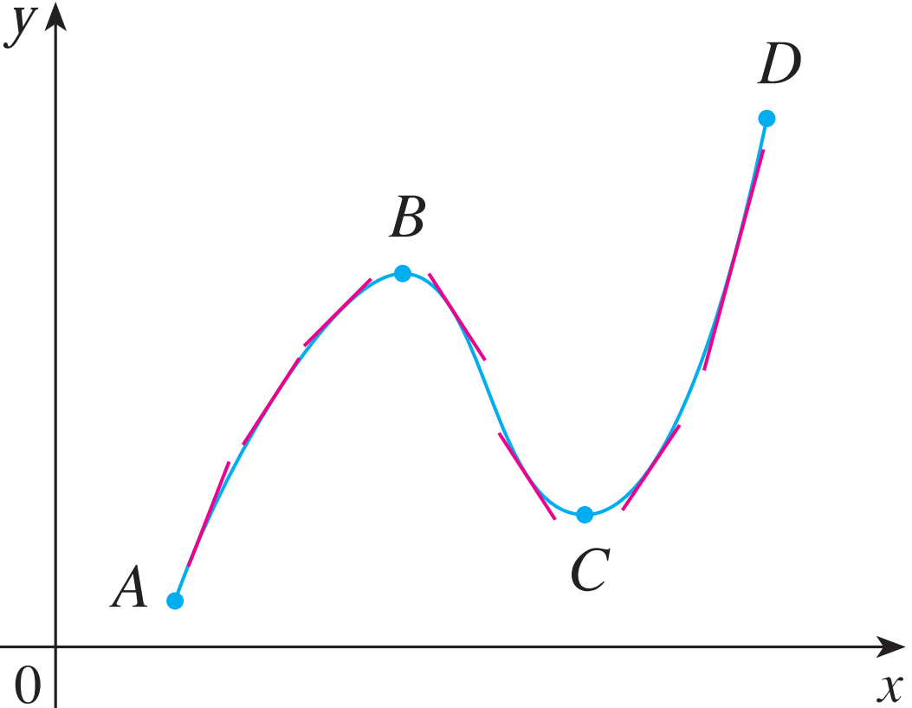
INCREASING / DECREASING TEST (I/D TEST)
If f’(x) > 0 on an interval (a,b), then f is increasing on that interval.
If f’(x) < 0 on an interval (a,b), then f is decreasing on that interval.

Slide 29
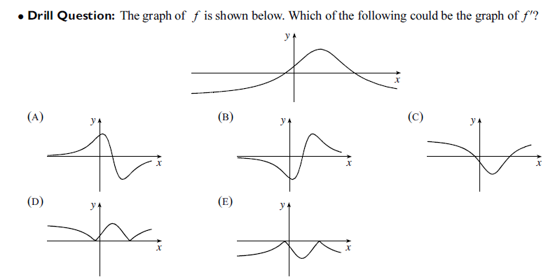
INCREASING / DECREASING TEST (I/D TEST)

Slide 30
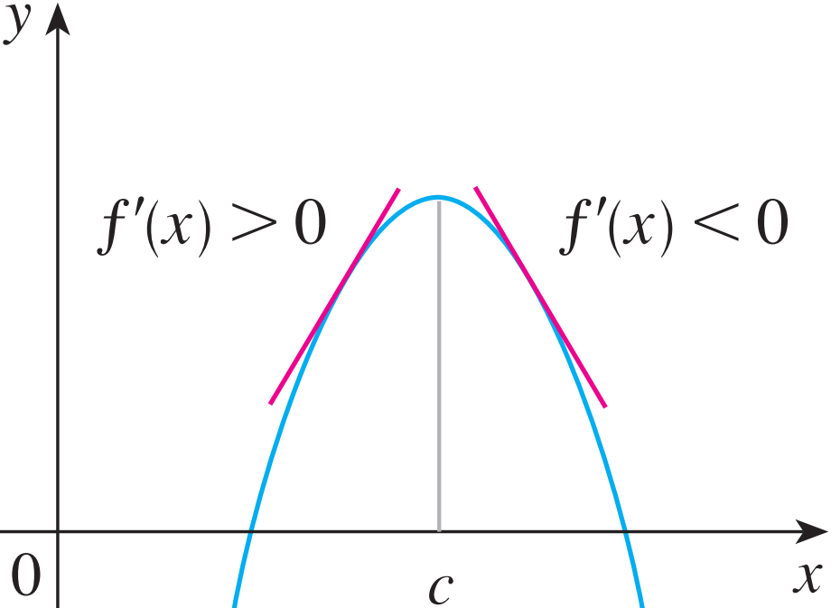

FIRST DERIVATIVE TEST
Suppose that c is a critical number of a continuous function f.
If f’ changes from positive to negative at c, then f has a local maximum at c.

Slide 31
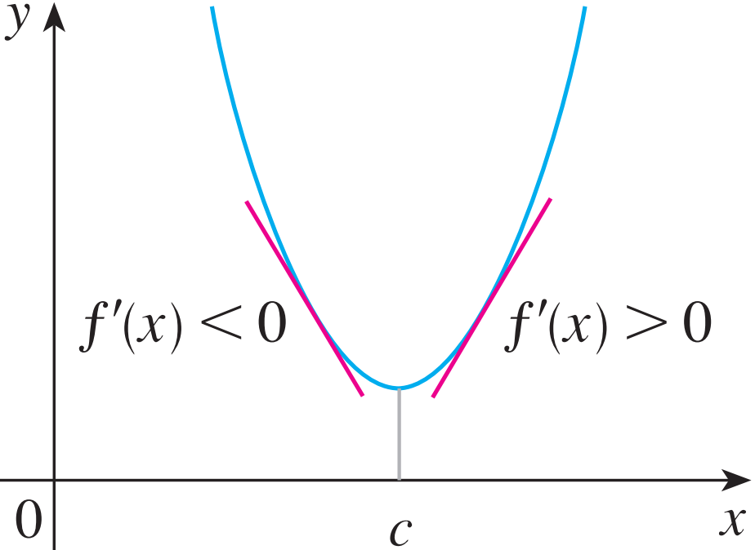

FIRST DERIVATIVE TEST
Suppose that c is a critical number of a continuous function f.
If f’ changes from positive to negative at c, then f has a local maximum at c.
If f’ changes from negative to positive at c, then f has a local minimum at c.

Slide 32
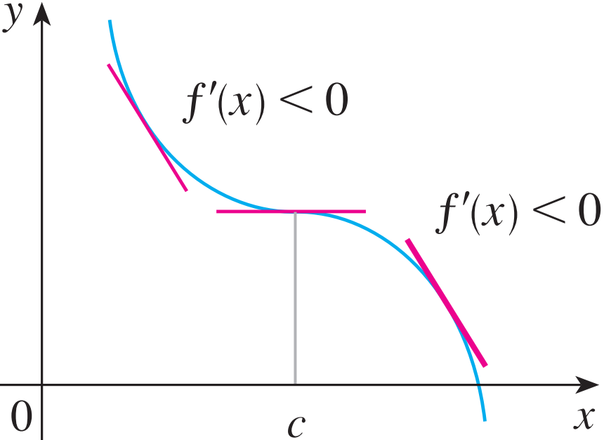
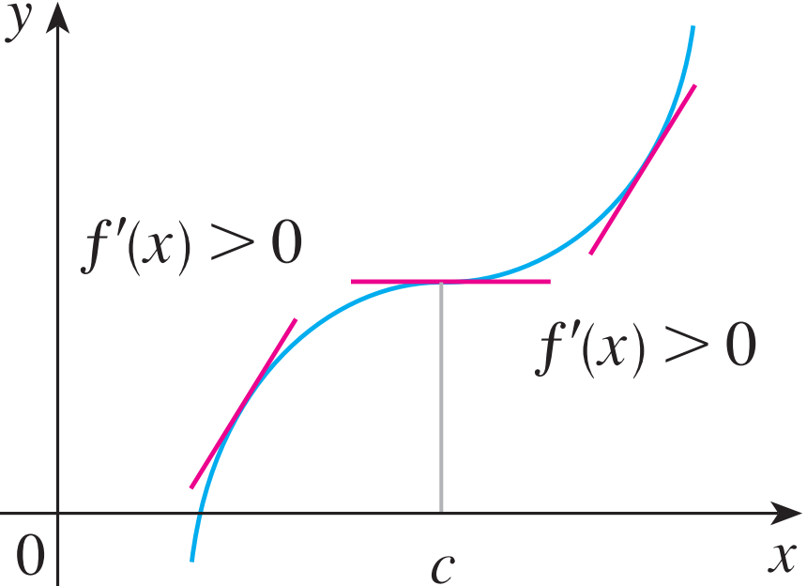
FIRST DERIVATIVE TEST
Suppose that c is a critical number of a continuous function f.
If f’ changes from positive to negative at c, then f has a local maximum at c.
If f’ changes from negative to positive at c, then f has a local minimum at c.
If f’ does not change sign at c, then f has no local maximum or minimum at c.

Slide 33
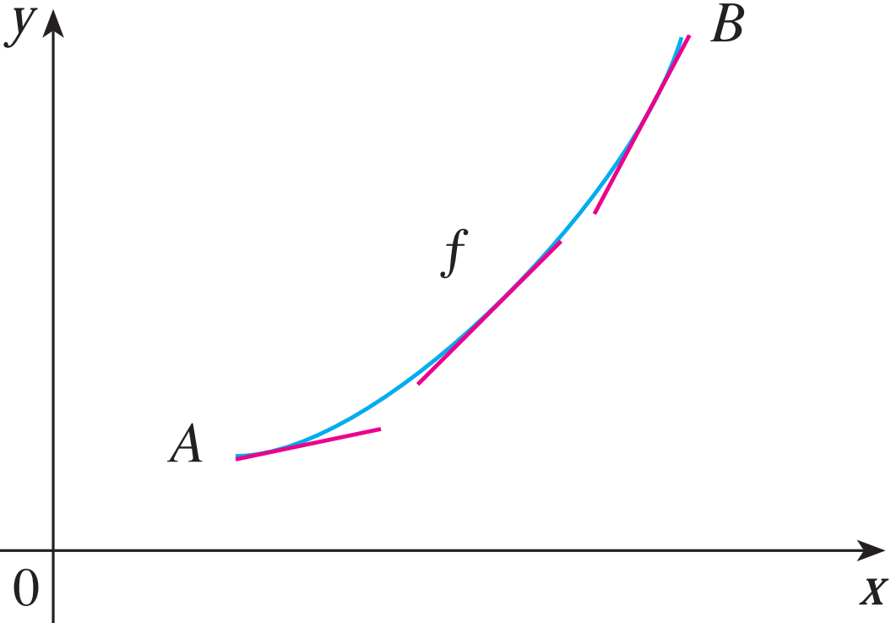
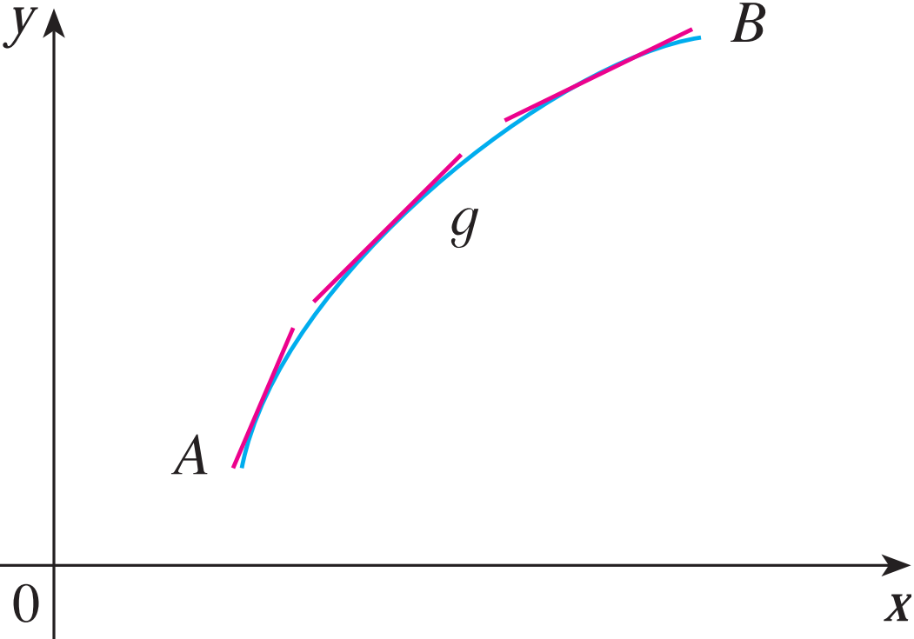
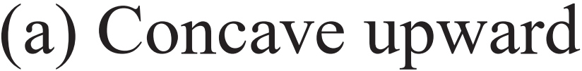

CONCAVE UPWARD/DOWNDWARD
Definition:
The curve lies above the tangents and f is called concave upward (lõm lên) on (a, b).
The curve lies below the tangents and g is called concave downward (lõm xuống) on (a, b).

Slide 34
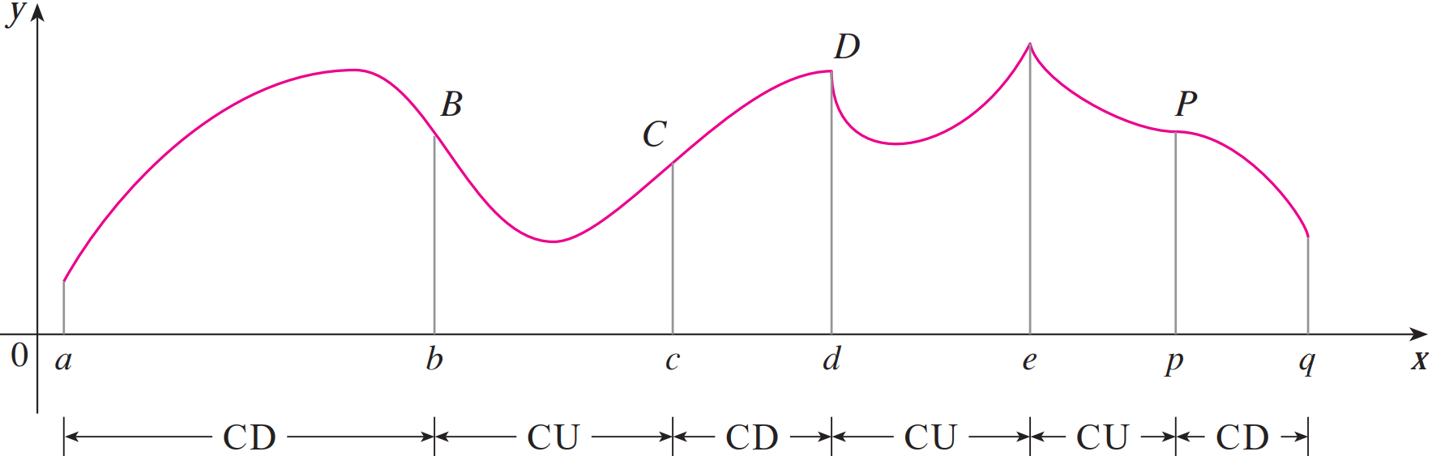
CONCAVITY TEST
If f’’(x) > 0 for all x in I, then the graph of f is concave upward on I.
If f’’(x) < 0 for all x in I, then the graph of f is concave downward on I.

Slide 35
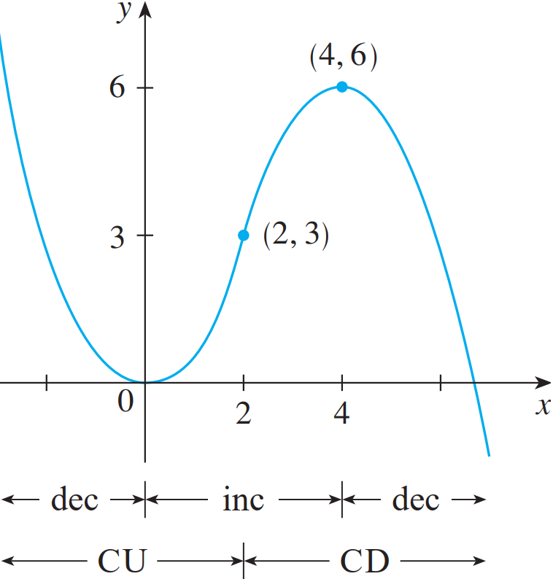
INFLECTION POINT—DEFINITION
Definition:
A point P on a curve y = f(x) is called an inflection point (điểm uốn) if f is continuous there and the curve changes from concave upward to concave downward (or from concave downward to concave upward at P).

Slide 36
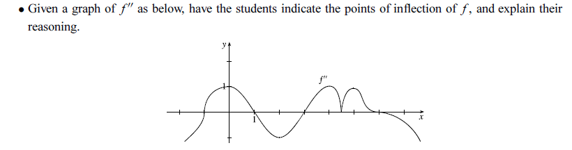
INFLECTION POINT—DEFINITION
Example:

Slide 37
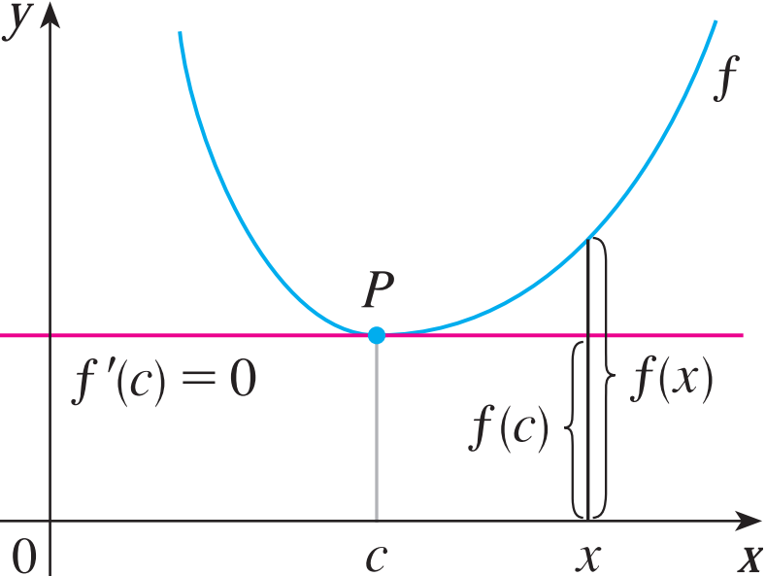
SECOND DERIVATIVE TEST
Suppose f ’’ is continuous near c.
If f ’(c) = 0 and f ’’(c) > 0, then f has a local minimum at c.
If f ’(c) = 0 and f ’’(c) < 0, then f has a local maximum at c.
Note:
The Second Derivative Test is inconclusive when f ’’(c) = 0.
This test also fails when does not exist.

Slide 38
SECOND DERIVATIVE TEST
Example: Consider functions:
a.
b.
The function f ”(x) is discontinuous at x = 0 and x = 6, so the definition must be used when testing the inflection point.

Slide 39
Quiz.
Choose the correct one.
A. If f has local extreme value at c then f ’(c) = 0.
B. If f ’(c) = 0 then f has local extreme value at c.
C. If f ’’(3) = 0 then (3, f (3)) is an inflection point of f.
D. There exists a function such that f ’(x) is nonzero for all x and f (1) = f (0).
E. None of the above.

Slide 40
3.5. APPLICATIONS OF DIFFERENTIATION Optimization Problems
In this section, we will learn:
How to solve problems involving
maximization and minimization of factors.

Slide 41
UNDERSTAND THE PROBLEM
Read the problem carefully until it is clearly understood.
What is the unknown?
What are the given quantities?
What are the given conditions?

Slide 42
FIND THE ABSOLUTE MAX./MIN. VALUE OF f
Use the methods of Sections 3.1 and 3.3 to find the absolute maximum or minimum value of f.
In particular, if the domain of f is a closed interval, then the Closed Interval Method in Section 3.1 can be used.
Example:
Find two positive numbers such that the sum is 24 and the product is the largest?
Find two positive numbers such that the product is 36 and the sum is the smallest?
(Answer: 12, 12.)
(Answer: 6, 6.)

Slide 43
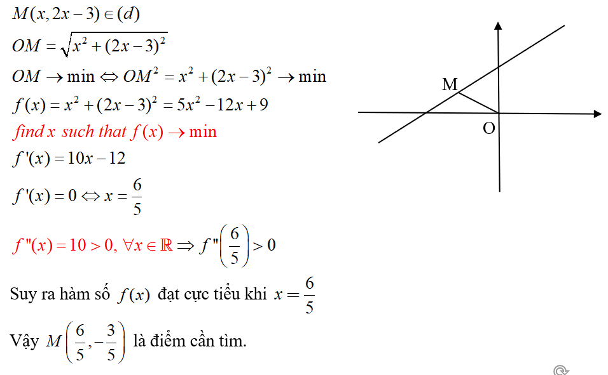
OPTIMIZATION PROBLEMS
Example 1: Find the point on the line (d) y = 2x - 3 that is closest to the origin.

Slide 44
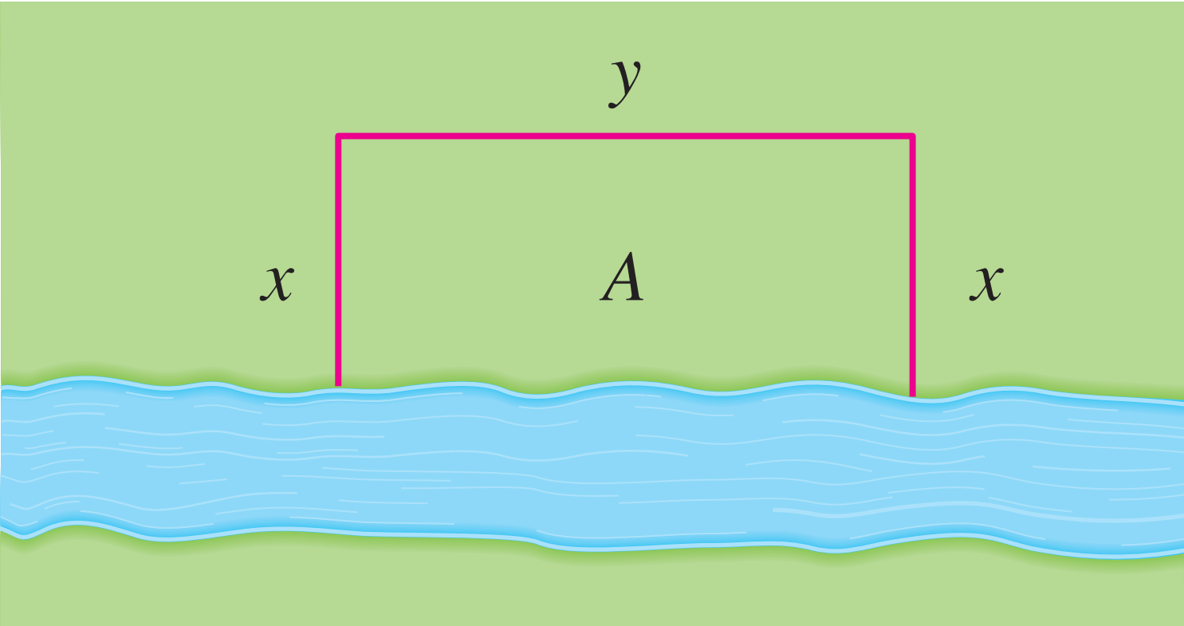
OPTIMIZATION PROBLEMS
Example 2: A farmer has 2400 ft of fencing and wants to fence off a rectangular field that borders a straight river. He needs no fence along the river.
What are the dimensions of the field that has the largest area ?

Slide 45
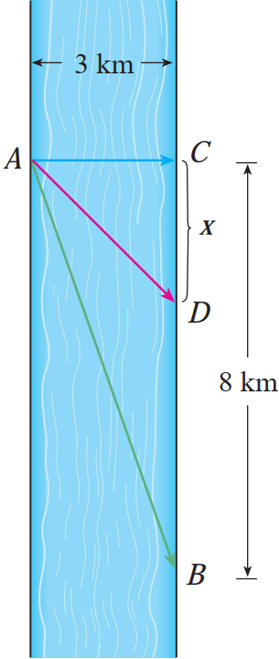
OPTIMIZATION PROBLEMS
Example 3: A man launches his boat from point A on a bank of a straight river, 3 km wide, and wants to reach point B (8 km downstream on the opposite bank) as quickly as possible.
If he can row 6 km/h and run 8 km/h, where should he land to reach B as soon as possible?

Slide 46
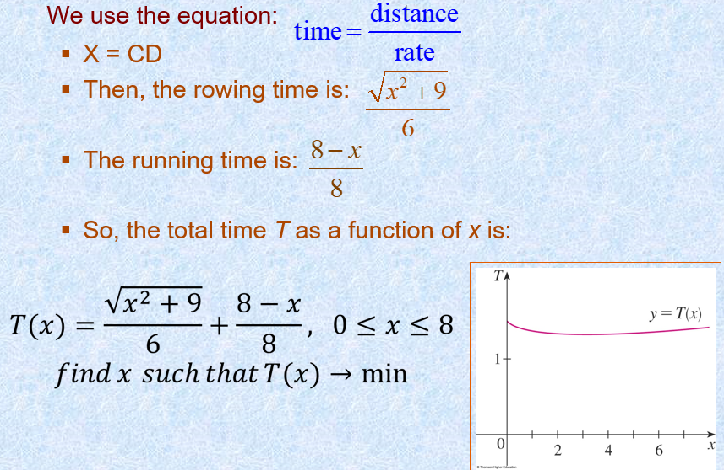
OPTIMIZATION PROBLEMS
Example 3:

Slide 47
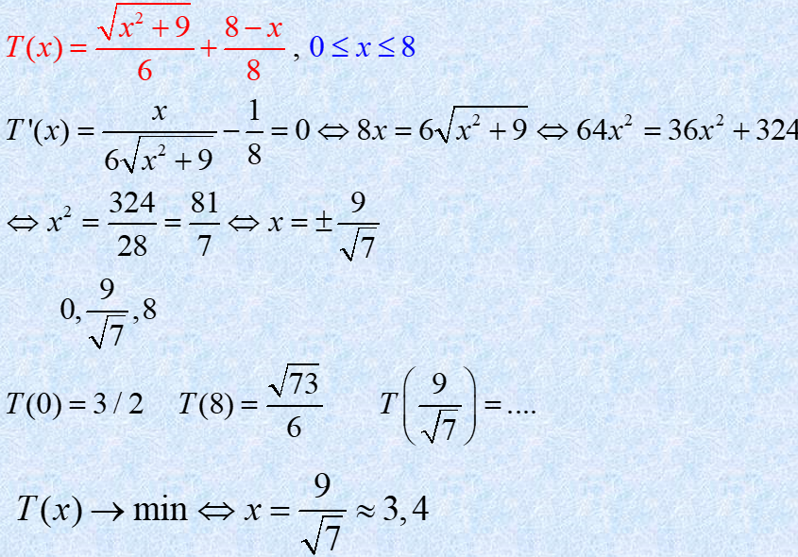
OPTIMIZATION PROBLEMS
Example 3:

Slide 48
OPTIMIZATION PROBLEMS
Example 4:
A rectangular storage container with an open top is to have a volume of 15 m³ The length of its base is twice the width.
Material for the base costs $10 per square meter. Material for the sides costs $6 per square meter. Find the cost of materials for the cheapest such container.
Homework.

Slide 49
3.6. APPLICATIONS OF DIFFERENTIATION Newton’s Method
In this section, we will learn:
How to solve high-degree equations
using Newton’s method.
Notes:
Phương pháp Newton và ứng dụng của nó. Giải thích hình học của phương pháp Newton. Tốc độ xấp xỉ của phương pháp Newton.

Slide 50
NUMERICAL ROOTFINDERS
How do those numerical root finders work?
They use a variety of methods.
Most, though, make some use of Newton’s method, also called the Newton-Raphson method.

Slide 51
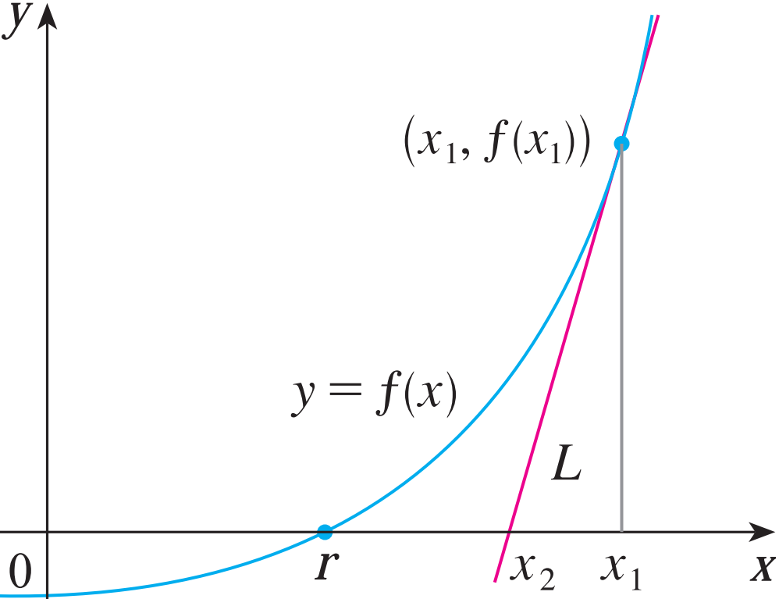
NEWTON’S METHOD
We start with a first approximation x₁, which is obtained by one of the following methods:
Guessing.
A rough sketch of the graph of f.
A computer - generated graph of f.

Slide 52
NEWTON’S METHOD
Consider the tangent line L to the curve y = f (x) at the point (x₁, f (x₁)) and look at the x-intercept of L, labeled x₂.

Slide 53
NEWTON’S METHOD
As the x-intercept of L is x₂, we set y = 0 and obtain:
0 - f (x₁) = f ’(x₁)(x₂ - x₁)
If f ’(x₁) ≠ 0, we can solve this equation for x₂ :
We use x₂ as a second approximation to r.

Slide 54
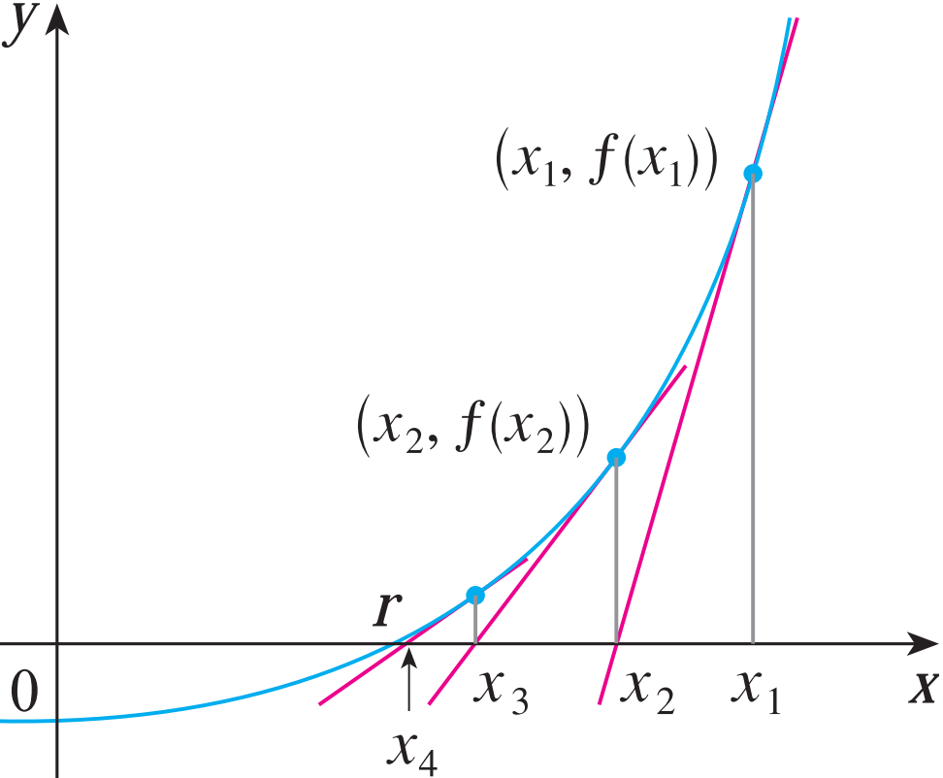

NEWTON’S METHOD
In general, if the nth approximation is x_{n} and f ’(x_{n}) ≠ 0, then the next approximation is given by:

Slide 55
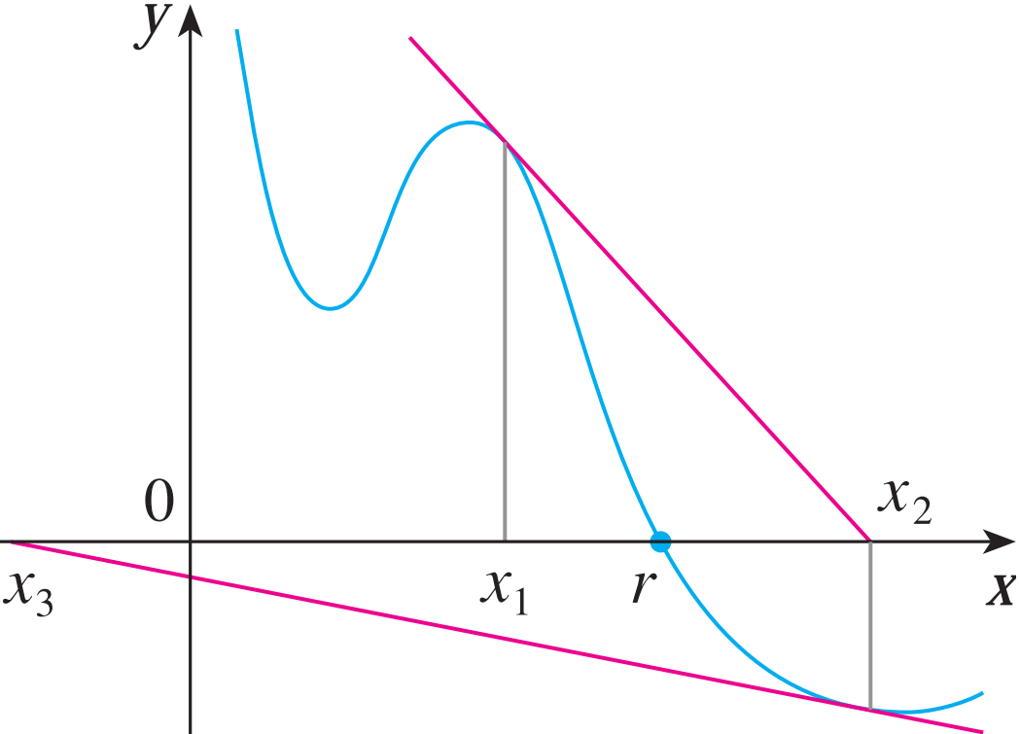

NEWTON’S METHOD
If the numbers x_{n} become closer and closer to r as n becomes large, then we say that the sequence converges to r and we write:
Although the sequence of successive approximations converges to the desired root for functions of the type illustrated in Figure 3, in certain circumstances the sequence may not converge. For example, consider the situation shown in Figure 4. You can see that x2 is a worse approximation than x1. This is likely to be the case when f ’(x1) is close to 0. It might even happen that an approximation (such as x3 in Figure 4) falls outside the domain of . Then Newton’s method fails and a better initial approximation x1 should be chosen. See Exercises 29–32 for specific examples in which Newton’s method works very slowly or does not work at all
Notes:
Mặc dù chuỗi các xấp xỉ liên tiếp hội tụ đến nghiệm mong muốn đối với các hàm thuộc loại được minh họa trong Hình 3, nhưng trong một số trường hợp nhất định, chuỗi này có thể không hội tụ. Ví dụ, xem xét tình huống được minh họa trong Hình 4. Bạn có thể thấy rằng x2 là một xấp xỉ kém hơn x1 . Đây có thể là trường hợp khi f'(x1) gần bằng 0. Thậm chí có thể xảy ra trường hợp một xấp xỉ (chẳng hạn như x3 trong Hình 4) nằm ngoài miền của . Khi đó phương pháp của Newton không thành công và nên chọn một xấp xỉ ban đầu tốt hơn x1. Xem Bài tập 29–32 để biết các ví dụ cụ thể trong đó phương pháp của Newton hoạt động rất chậm hoặc hoàn toàn không hoạt động

Slide 56
NEWTON’S METHOD
Example:
Use Newton’s method to find correct to eight decimal places.
First, we observe that finding is equivalent to finding the positive root of the equation x⁶ – 2 = 0
So, we take f (x) = x⁶ – 2.
Then, f ’(x) = 6x⁵.
So, Formula 2 (Newton’s method) becomes:

Slide 57
NEWTON’S METHOD
Formula 2 (Newton’s method) becomes:
Choosing x₁ = 1 as the initial approximation, we obtain:
As x₅ and x₆ agree to eight decimal places, we conclude that to eight decimal places.

Slide 58
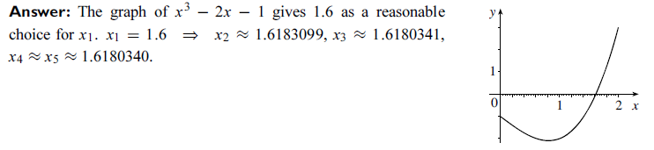
NEWTON’S METHOD

Slide 59
3.7. APPLICATIONS OF DIFFERENTIATION Antiderivatives
In this section, we will learn about:
Antiderivatives and how they are useful
in solving certain scientific problems.
Notes:
Phương pháp Newton và ứng dụng của nó. Giải thích hình học của phương pháp Newton. Tốc độ xấp xỉ của phương pháp Newton.

Slide 60
ANTIDERIVATIVES
Definition:
A function F is called an antiderivative of f on an interval (a,b) if F’(x) = f(x) for all x in (a,b).
Theorem:
If F is an antiderivative of f on an interval (a,b), the most general antiderivative of f on (a,b) is F(x) + C , where C is an arbitrary constant.
Example:
Let f (x) = tanx, and F(x) is an antiderivative of f (x). Evaluate f and tell whether F is increasing or decreasing at x = - 3 (rad).

Slide 61
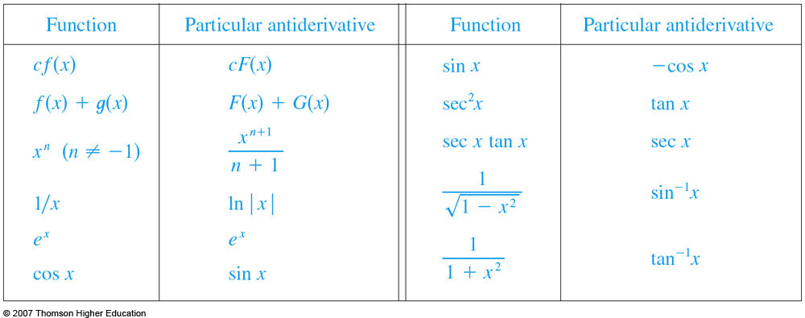
ANTIDERIVATIVES FORMULA
Here, we list some particular antiderivatives.

Slide 62
ANTIDERIVATIVES FORMULA
Example:
A particle moves in a straight line and has acceleration given by
a(t) = 6t + 4.
Its initial velocity is v(0) = -6 cm/s and its initial displacement is s(0) = 9 cm. Find its position function s(t) ?
Remind: s’(t) = v(t) và s”(t) = (v(t))’= a(t).

Slide 63
Quiz.
1. A particle moves along the x-axis so that its velocity at time t is given by 3sin(2t). Assuming it starts at the origin, where is it at t = π seconds?
a. -3/2. b. 3/2. c. ½. d. –½.
2. Let f (x) = 4 – 3x for all x ≥ 2. Select the correct one.
a. 2 is the local minimum value.
b. 2 is the local maximum value.
c. –2 is the local minimum value.
d. –2 is the maximum local value.
e. 2 is the absolute minimum value.
f. –2 is the absolute maximum value.
g. None of the above.

Slide 64
Example:
A piece of wire (dây kim loại) 10 m long is cut into two pieces. One piece is bent into a square and the other is bent into an equilateral triangle (tam giác đều).
How should the wire be cut for the square so that the total area (of the square and the triangle) enclosed is a minimum? Round the result to the nearest hundredth.

